Slide 1
DROWSINESS DETECTION
RANI JAYAN
S3 MCA
LMCST

Slide 2
CONTENT
ABSTRACT
EXSISTING SYSTEM
PROPOSED SYSTEM
REQUIREMENTS
OBJECTIVES
FLOW DIAGRAM
SCREENSHOTS
FURURE ENHANCEMENT
CONCLUTION

Slide 3
ABSTRACT
Driver drowsiness is a primary cause of several highway calamities leads to severe physical injuries, loss of money, and loss of human life.
The implementation of driver drowsiness detection in real-time will aid in avoiding major accidents.
The system is designed for driver’s fatigue or drowsiness is detected and alerts the person.

Slide 4
EXISTING SYSTEM
Drowsiness is a state of near sleep, where the person has a strong desire for sleep. It has two distinct meanings, referring both to the usual state preceding falling asleep and the chronic condition referring to being in that state independent of a daily rhythm . Sleepiness can be dangerous when performing tasks that require constant concentration, such as driving a vehicle. When a person is sufficiently fatigue while driving, they will experience drowsiness and this leads to increase the factor of road accident.
The development of technologies for detecting or preventing drowsiness while driving is a major challenge in the field of accident avoidance system. Because of the hazard that drowsiness presents on the road, methods need to be developed for counteracting its affects.

Slide 5
PROPOSED SYSTEM
In order to solve the problems in the previous system, the existing system is needed to evolve. Current drowsiness detection systems monitoring the driver’s condition requires complex computation and expensive equipment, not comfortable to wear during driving and is not suitable for driving conditions; for example, Electroencephalography (EEG) and Electrocardiography (ECG), ie. detecting the brain frequency and measuring the rhythm of heart, respectively. A drowsiness detection system which use a camera placed in front of the driver is more suitable to be use but the physical signs that will indicate drowsiness need to be located first in order to come up with a drowsiness detection algorithm that is reliable and accurate.
Therefore, this project aims to analyse all the previous research and method, hence propose a method to detect drowsiness by using video or webcam. It analyses the video images that have been recorded and come up with a system that can analyses each frame of the video.

Slide 6
REQUIREMENTS
HARDWARE
Camera
Speaker
RAM 1GB and upper
SOFTWARE
OS (Linux, Window)
Python3
Libraries
imutils
imutils.video,VedioStream
time
dlib
cv2
numpy
playsound

Slide 7
OBJECTIVES
To reduce the accidents
To prevent caused by the driver getting drowsy
To detect drowsiness
To alert if the driver is going to drowsiness

Slide 8
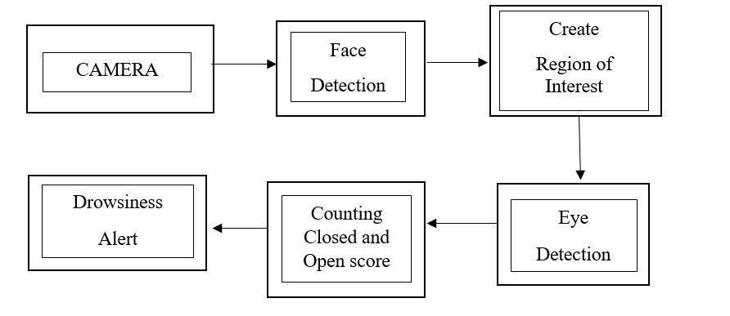
FLOW DIAGRAM

Slide 9
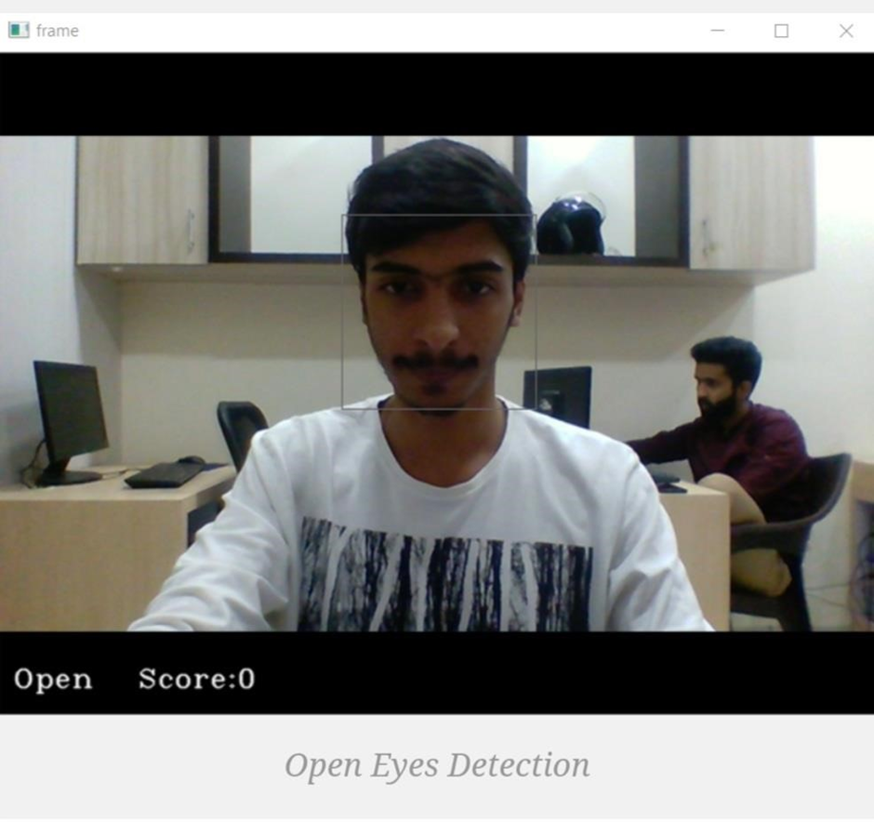
SCREENSHOTS

Slide 10
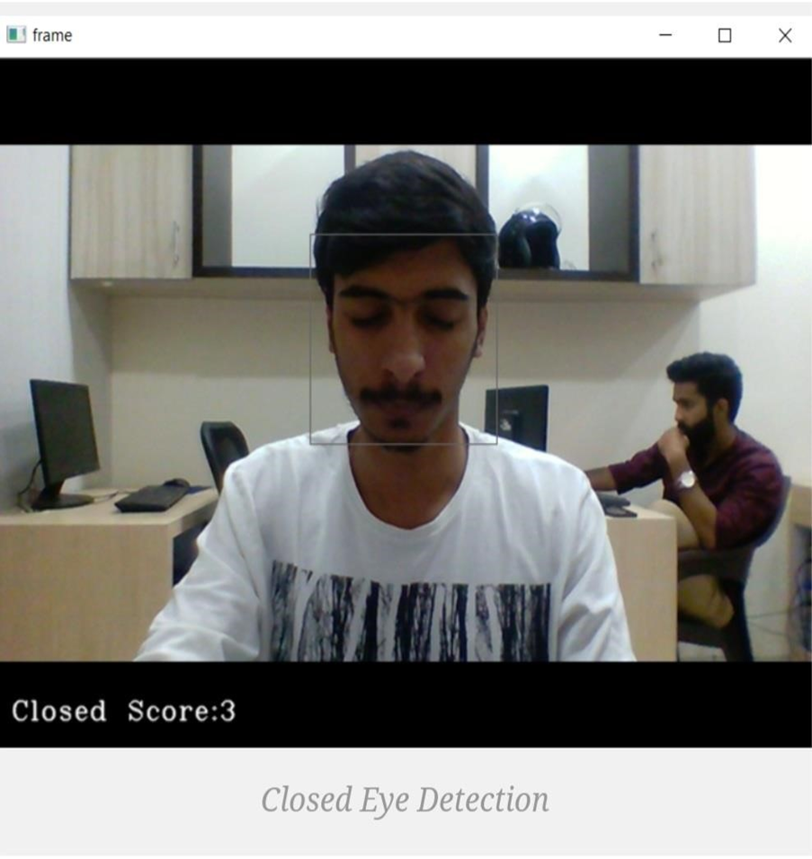

Slide 11
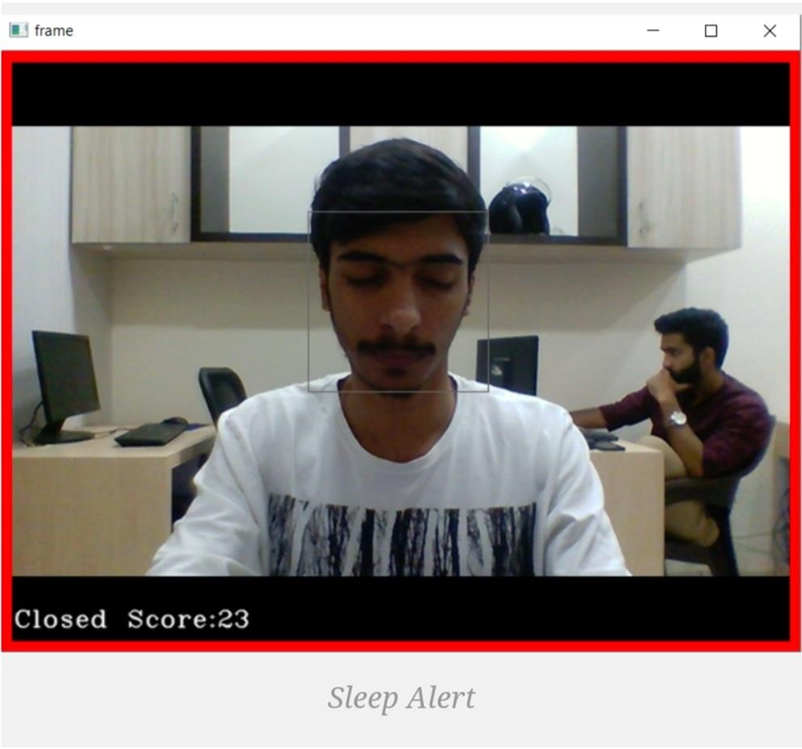

Slide 12
FUTURE ENHANCEMENT
The future work can include integration of the proposed system with globally used applications like Uber and Ola. The system, if integrated, can reduce the number of casualties and injuries that happen regularly due to these drowsy states of the drivers. This experiment can run as a part of pilot plan i.e. for a few days/months in different regions of the world where such incidents occur regularly. Thus, our proposed approach also gives the same accuracy for the people wearing spectacles. Accuracy of our proposed system improves with the increase in brightness of the surrounding environment. The work can be extended for different types users such as bike riders or in different domains like railways, airlines etc.
This system can be implemented in various classroom application such as Google Meet, Zoom etc. If we implement this system in business domain we can use cloud storage to store the huge amount of output data. Some model and techniques can be used for various other uses like Netflix and other streaming services can detect when the user is asleep and stop the video accordingly. It can also be used in application that prevents user from sleeping.

Slide 13
CONCLUTION
Driver drowsiness detection is designed mainly to keep the driver awake while driving to avoid the accident to sleepiness.

Slide 14
THANK YOU

